Slide 1
Modelling Pandemics
Abhishek Deshpande
Soham Joshi
Varad Deshmukh
Shrirang Karandikar
Intel AI Summit, September 2020

Slide 2
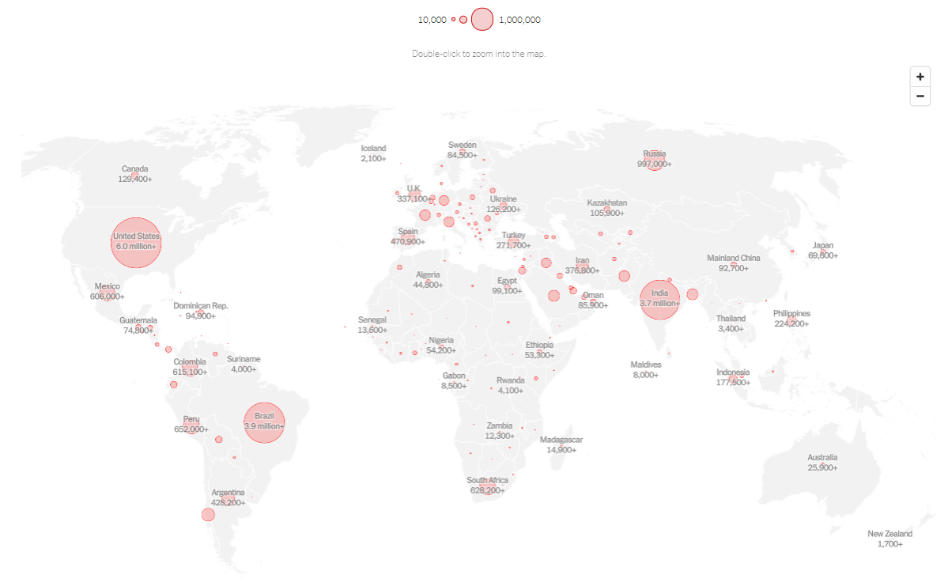
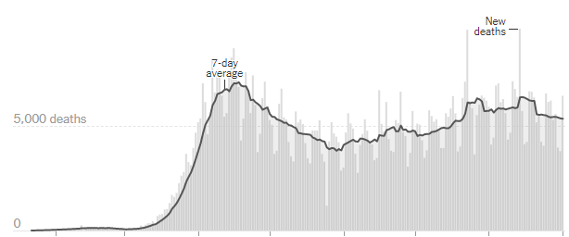
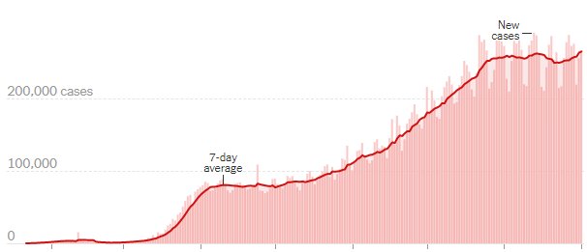
Infected
25,909,460
Deaths
861,346
Notes:
Data as of 02 September, 2020
Map Courtesy nytimes: https://www.nytimes.com/interactive/2020/world/coronavirus-maps.html
Data Courtesy John Hopkins Coronavirus Research Center
New Cases / day : 260K
Deaths / day: 4K

Slide 3
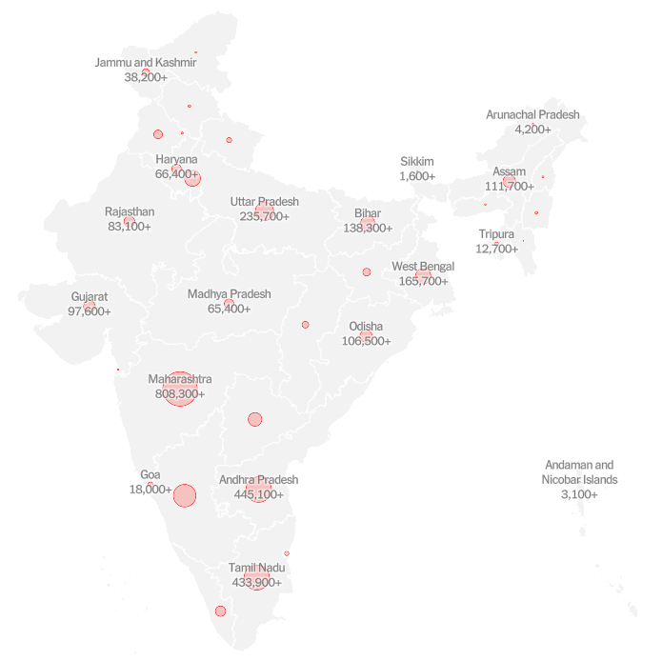
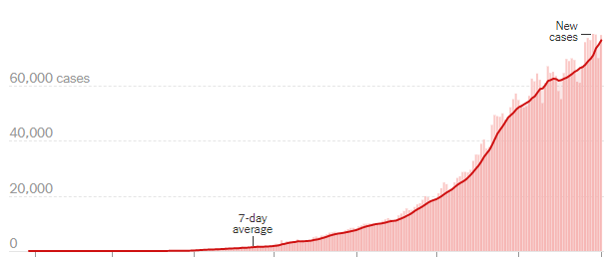
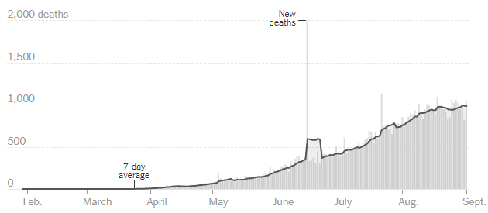
Infected
3,769,523
Deaths
66,333
Notes:
Data as of 02 September, 2020
Map Courtesy nytimes: https://www.nytimes.com/interactive/2020/world/asia/india-coronavirus-cases.html#map
Data Courtesy John Hopkins Coronavirus Research Center
New Cases / day : 78K
Deaths / day: 800

Slide 4

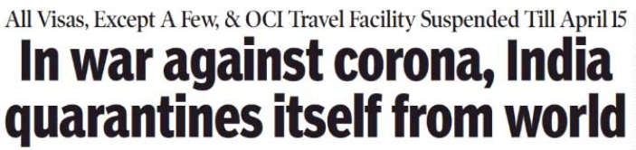
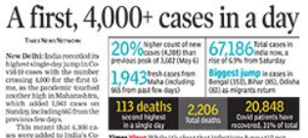

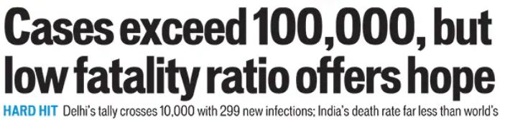



Hindustan Times, January 2020
Times Of India, March 2020
Times Of India, May 2020
Times Of India, May 2020
Asian Age, May 2020
Hindustan Times, April 2020
Hindustan Times, May 2020
Hindustan Times, May 2020
Asian Age, June 2020
Notes:
Headline categories
Spread of the pandemic
Govt. reaction (lockdown) + policies
Human impact/interest

Slide 6




$$\frac{dS}{dt}=Λ−rβS\frac{I}{N}−μS$$
$$\frac{dE}{dt}=rβS\frac{I}{N}−εE$$
$$\frac{dI}{dt}=εE−γI−μI$$
$$\frac{dR}{dt}=γI−μR$$
Recovered
Susceptible
Exposed
Infected
Dead

Slide 7
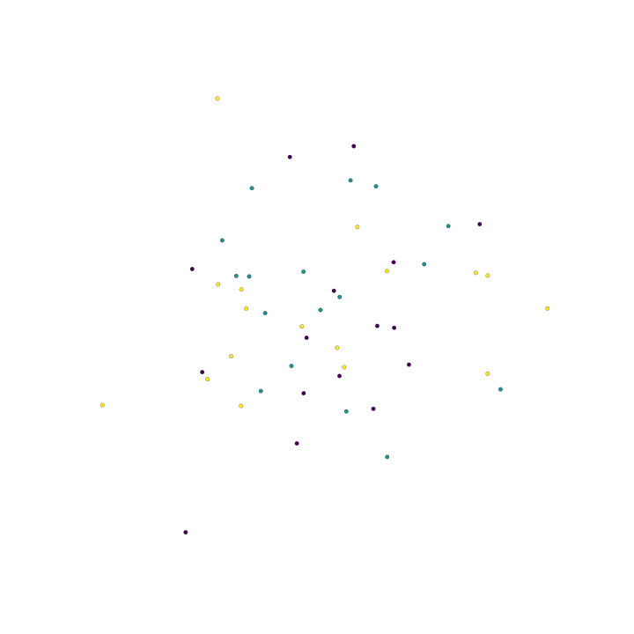
Modelling the Population
Individuals are represented by nodes
Nodes can belong to different clusters

Slide 8
Modelling the Population
Connections between individuals are represented by edges
Weight of an edge represents the probability of transmission

Slide 9
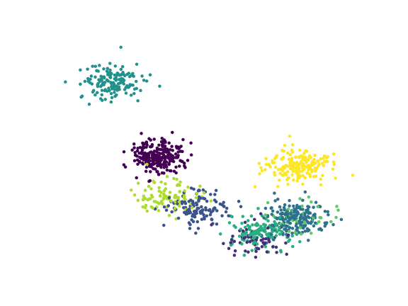
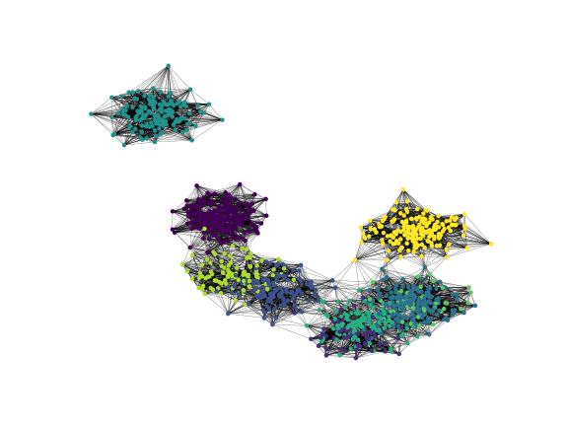
Modelling the Population
Traditional Approach
Add random edges in the population
Follow a reasonable distribution
Low connectivity across clusters
Node degrees: power law
High connectivity within a cluster
Notes:
Umap is a dimension reduction technique for general non-linear dimension reduction. We assume that the data is uniformly distributed on a Reimannian manifold, the Reimannian metric is locally constant and the manifold is locally connected.
We model the manifold with a fuzzy topological structure

Slide 10
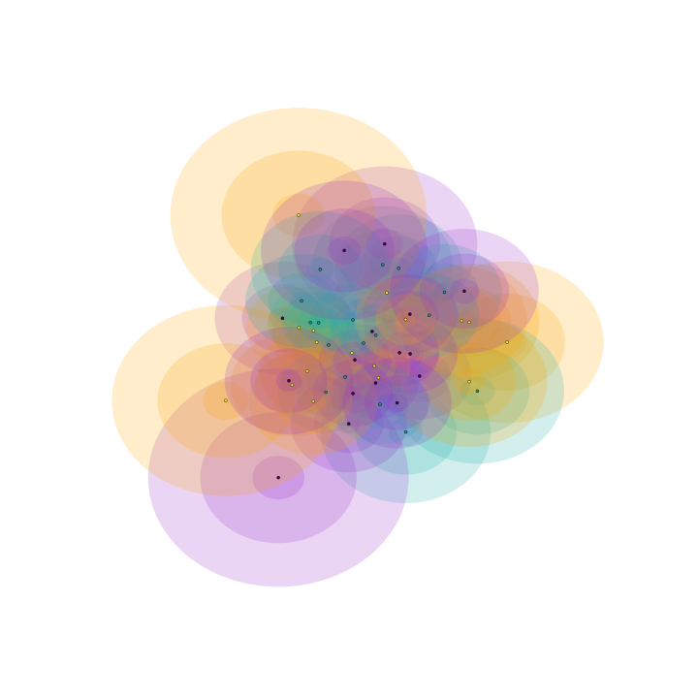
Modelling the Population
Fuzzy Simplicial Complexes

Slide 11
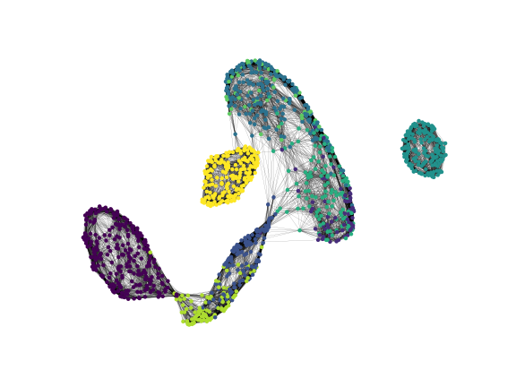
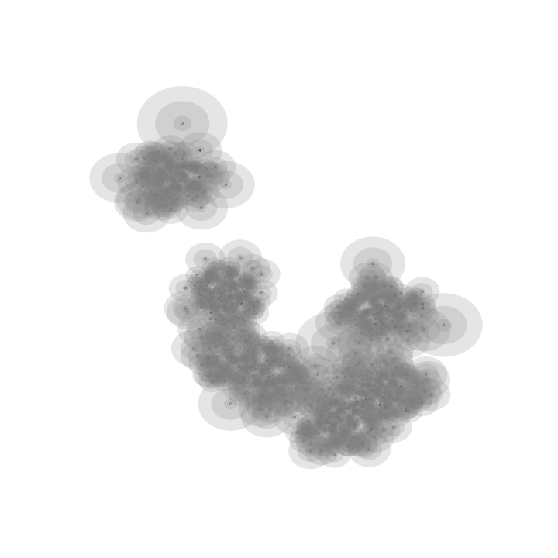
Modelling the Population
Notes:
Umap is a dimension reduction technique for general non-linear dimension reduction. We assume that the data is uniformly distributed on a Reimannian manifold, the Reimannian metric is locally constant and the manifold is locally connected.
We model the manifold with a fuzzy topological structure

Slide 12
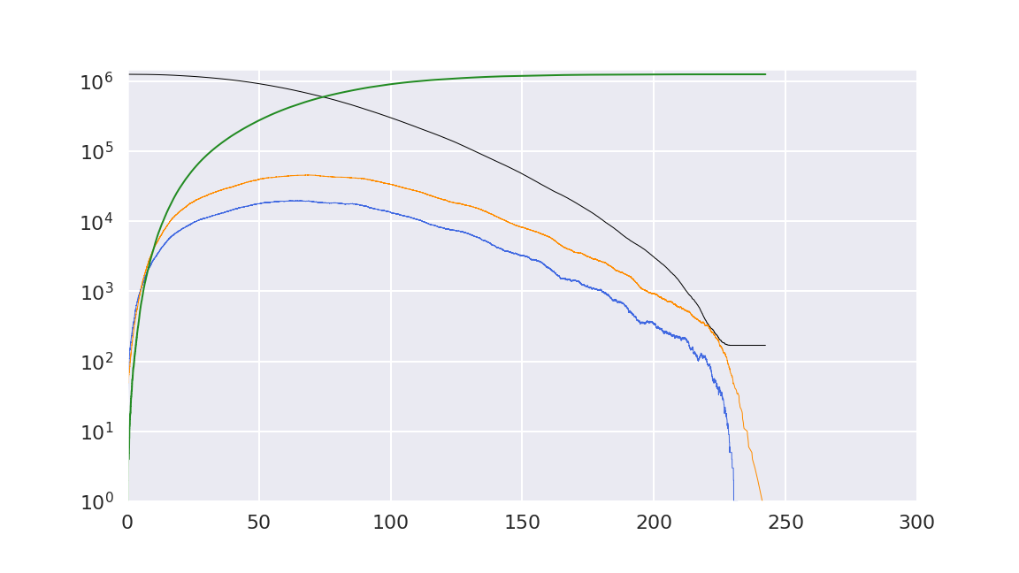




Initial Infections = 50
Transmission rate = 50%
Simulation Results
Recovered
$$\frac{dR}{dt}=γI−μR$$
Exposed
Susceptible
$$\frac{dE}{dt}=rβS\frac{I}{N}−εE$$
$$\frac{dS}{dt}=Λ−rβS\frac{I}{N}−μS$$
250 time steps 30 Minutes on
Intel Xeon Gold 6128 24 cores 192GB
Infected
$$\frac{dI}{dt}=εE−γI−μI$$

Slide 13
Initial Infections = 50
Transmission rate = 50%
Simulation Results
45K/day
69 days

Slide 14
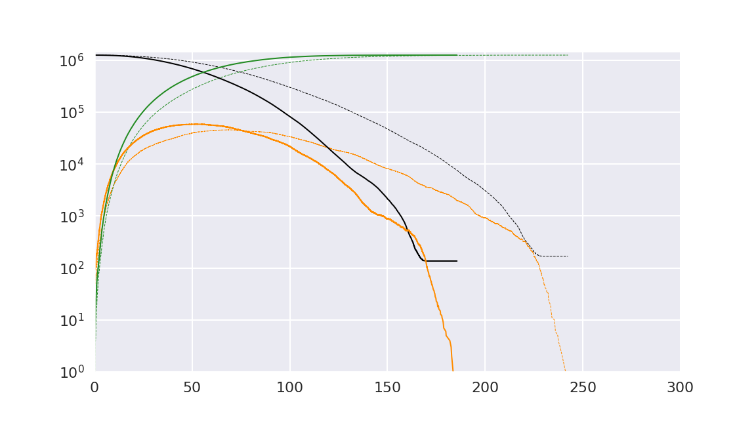
Initial Infections = 100
Transmission rate = 50%
Don’t Lockdown So Quickly!!
58K/day
45K/day
52 days
69 days
Notes:
100 people infected at start

Slide 15
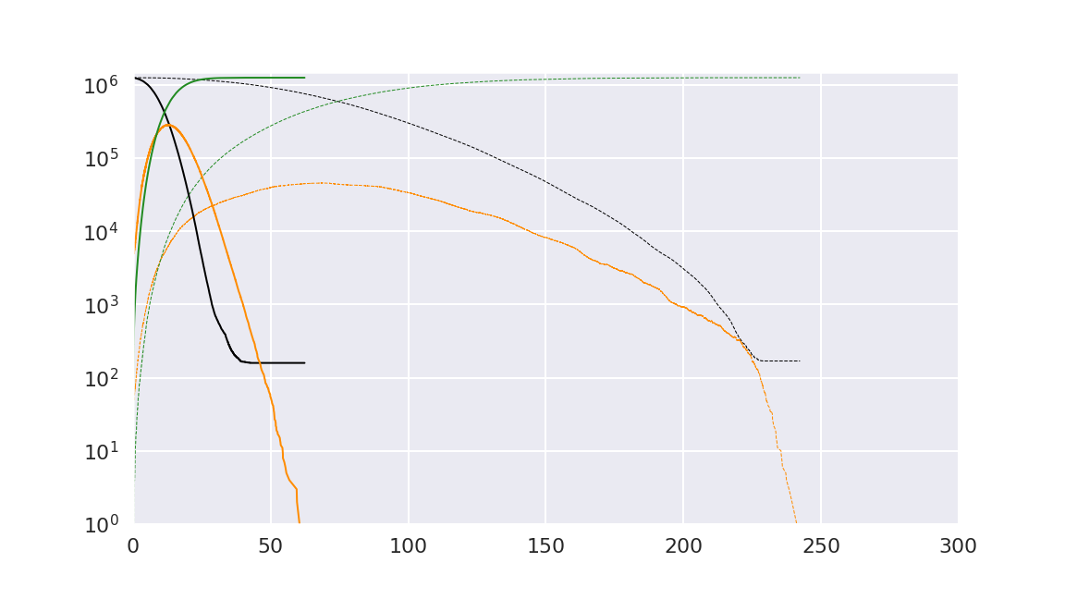
Initial Infections = 1,500
Transmission rate = 50%
Don’t Lockdown So Quickly!!
280K/day
45K/day
12 days
69 days
Notes:
1500 people infected at start

Slide 16
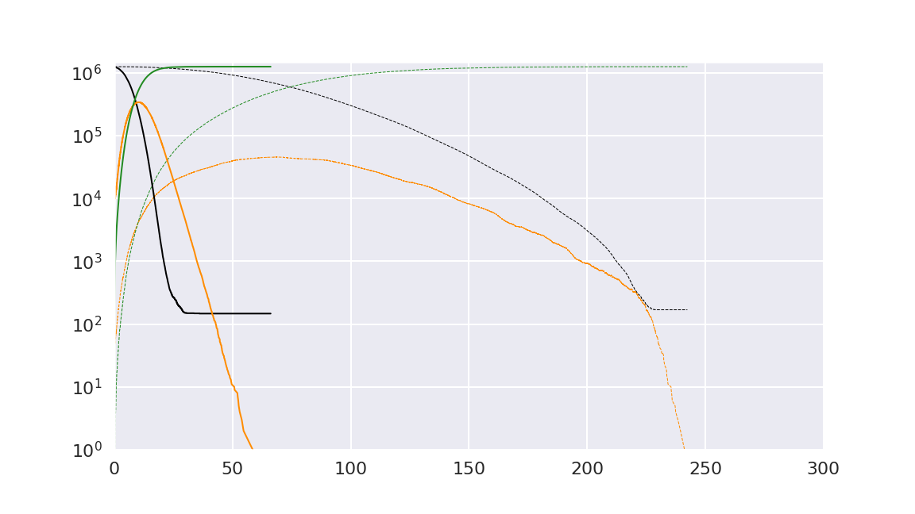
Initial Infections = 10,000
Transmission rate = 50%
Don’t Lockdown So Quickly!!
340K/day
45K/day
10 days
69 days
Notes:
10K starting infected
Didn’t matter after we crossed 1500 starting infections!

Slide 17
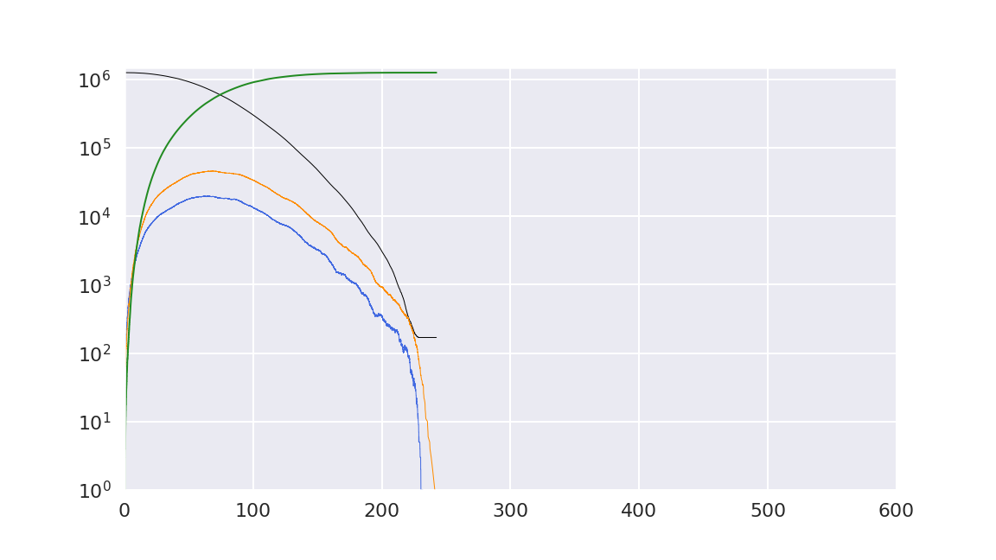
Initial Infections = 50
Transmission rate = 50%
Simulation Results
45K/day
69 days

Slide 18
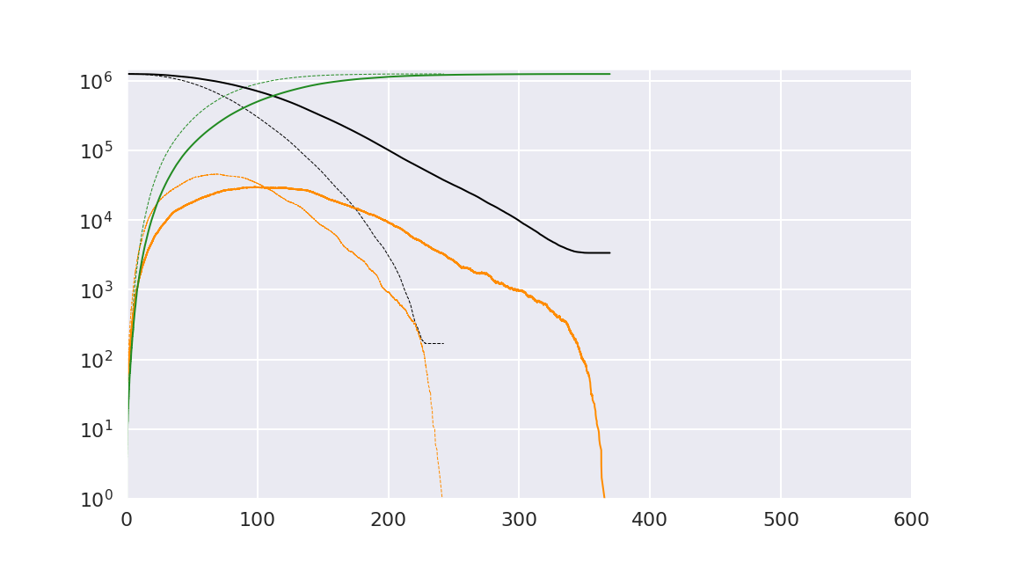
Initial Infections = 50
Transmission rate = 30%
What if the Virus isn’t as Bad?
45K/day
30K/day
98 days
69 days

Slide 19
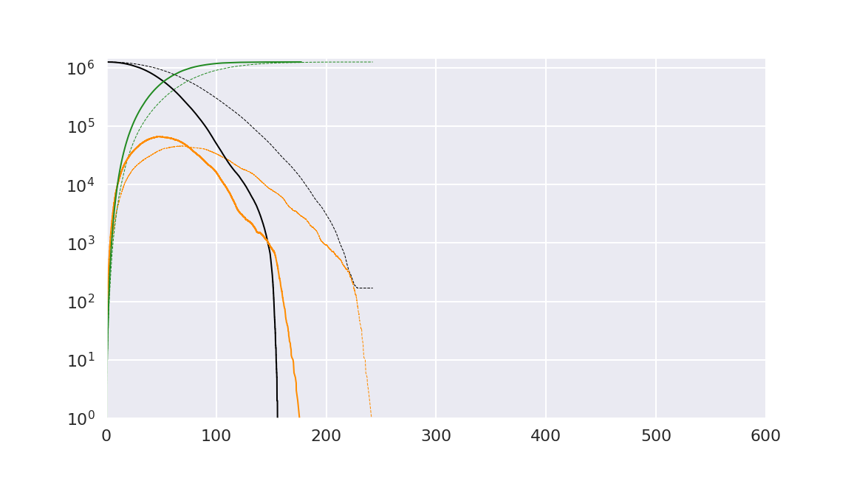
Initial Infections = 50
Transmission rate = 90%
What if the Virus is Worse?
66K/day
45K/day
48 days
69 days

Slide 20
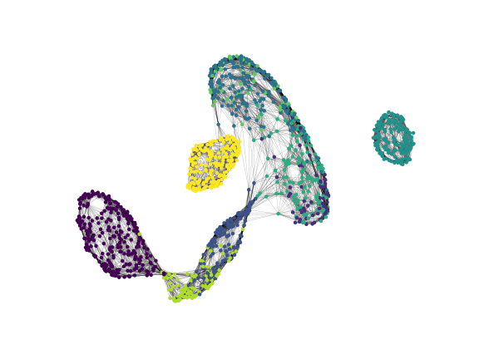

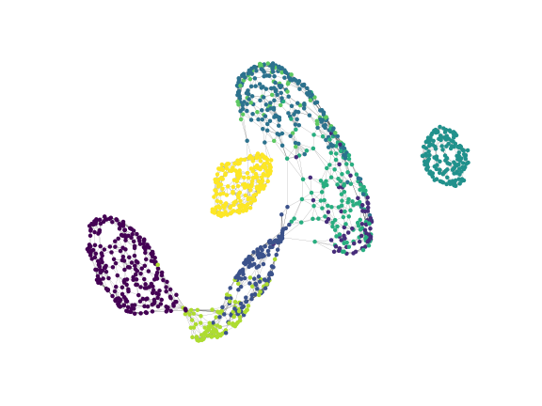
Lockdown effectiveness

Slide 21
Lockdown effectiveness

Slide 22
Lockdown Effectiveness
45K/day
69 days

Slide 23
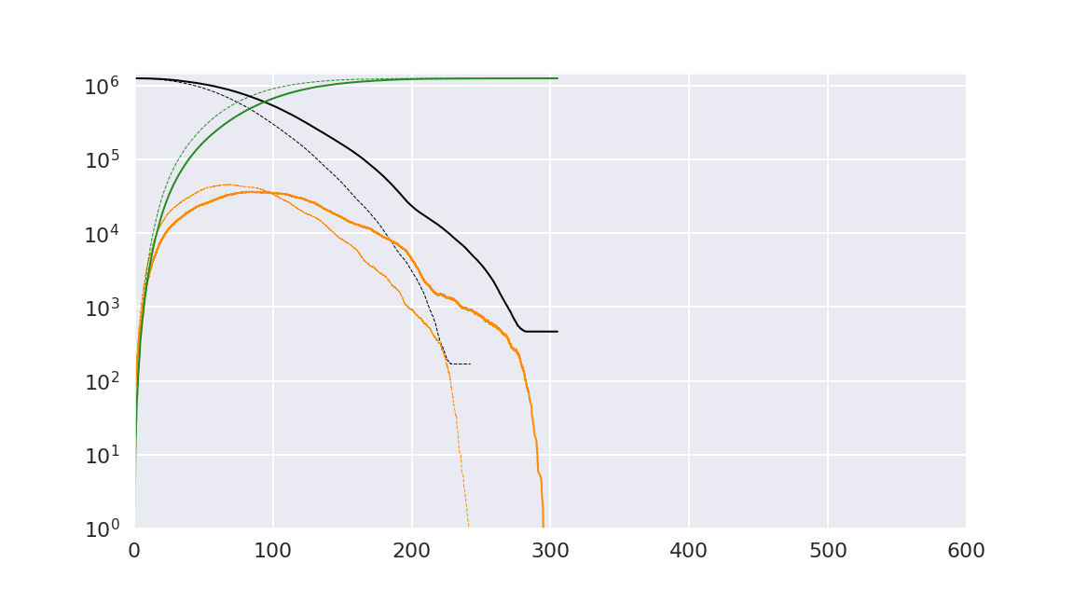
Lockdown Effectiveness
45K/day
36K/day
85 days
69 days

Slide 24
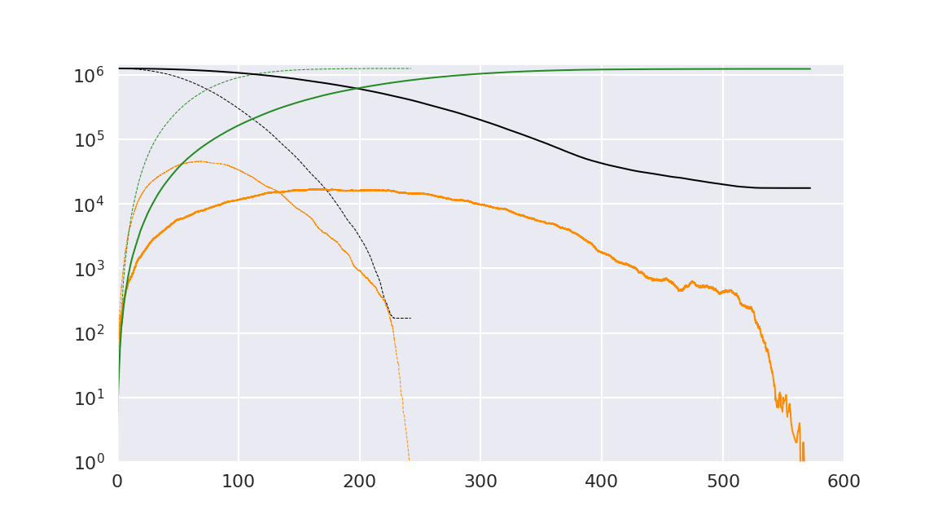
Lockdown Effectiveness
45K/day
16K/day
165 days
69 days

Slide 25

Let’s Isolate the Clusters

Slide 26
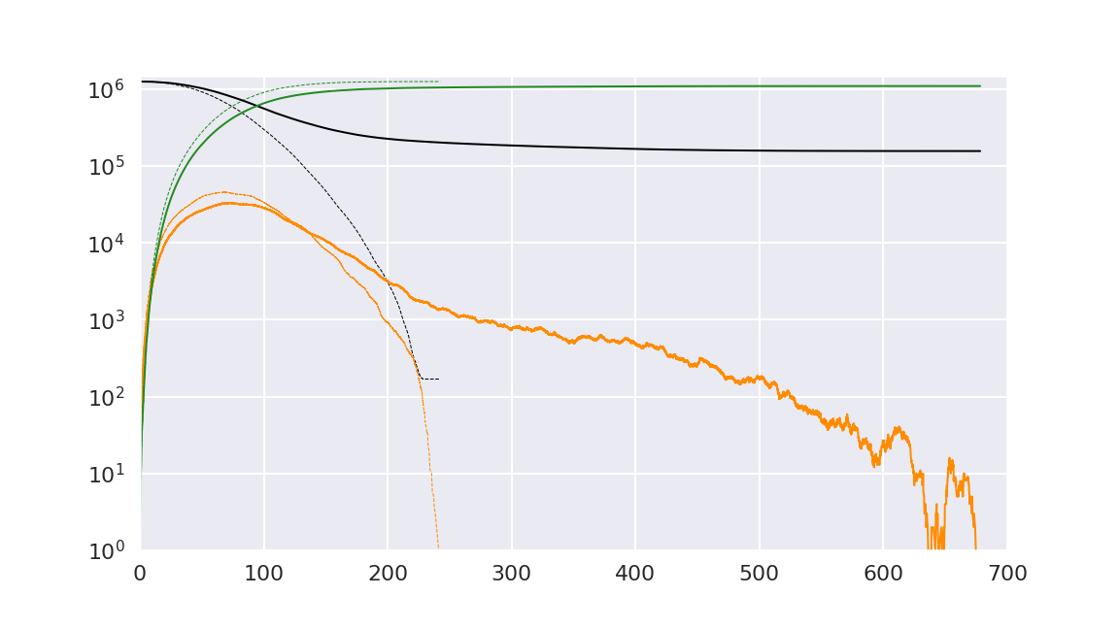
Let’s Isolate the Clusters
45K/day
33K/day
165 days
69 days

Slide 27
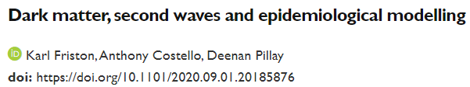
Epidemiological simulations are a powerful tool that help us understand
How the pandemic is spreading
What our options are
The impact of different decisions
“what-if”
Background Recent reports based on conventional SEIR models suggest that the next wave of the COVID-19 pandemic in the UK could overwhelm health services, with fatalities that far exceed the first wave. These models suggest non-pharmaceutical interventions would have limited impact without intermittent national lockdowns and consequent economic and health impacts.

Slide 28
Epidemiological simulations are a powerful tool that help us understand
How the pandemic is spreading
What our options are
The impact of different decisions
“what-if”
But only if performance is acceptable!
Capacity
Size of Population
Speed
Simulation Time (x2)
Scalability
Background Recent reports based on conventional SEIR models suggest that the next wave of the COVID-19 pandemic in the UK could overwhelm health services, with fatalities that far exceed the first wave. These models suggest non-pharmaceutical interventions would have limited impact without intermittent national lockdowns and consequent economic and health impacts.

Slide 29
High Abstraction High Granularity
Algorithm
Implementation
Hardware
Notes:
The better we map

Slide 30
High Abstraction High Granularity
Algorithm
Implementation
Hardware
Optimal performance == Optimal mapping
Notes:
The better we map

Slide 31
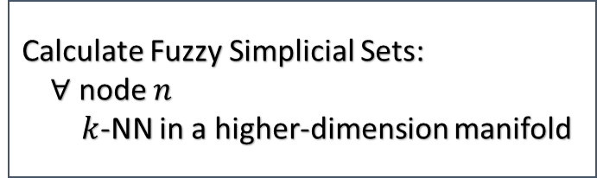
High Abstraction High Granularity
Algorithm
Implementation
Hardware
UMAP
Calculate Fuzzy Simplicial Sets:
$∀$ node $n$
$k$-NN in a higher-dimension manifold
Vectorization
Cache optimizations
Multithreading
Intel Frameworks: TBB
Sparse embedding:
Eigenvalues/vectors of a large,
sparse matrix
Stochastic gradient descent
Intel Optimized Libraries: MKL, SVML
Intel Optimized Libraries: numpy, numba, scikit-learn
Intel Distribution for Python

Slide 32
High Abstraction High Granularity
Algorithm
Implementation
Hardware
EoN SEIR
Vectorized implementations
Multi-threading
Cache optimizations
Event based simulations
Intel Frameworks: TBB
System of simultaneous differential equations
Intel Optimized Libraries: MKL, SVML
Intel Optimized Libraries: numpy, numba, scikit-learn
Intel Distribution for Python

Slide 33




Acknowledgements
Notes:
Python ecosystem, libraries too many to mention, but especially UMAP and EoN
OneAPI for the s/w
Intel for the support (incl. DevCloud) and technical collaboration

Slide 34
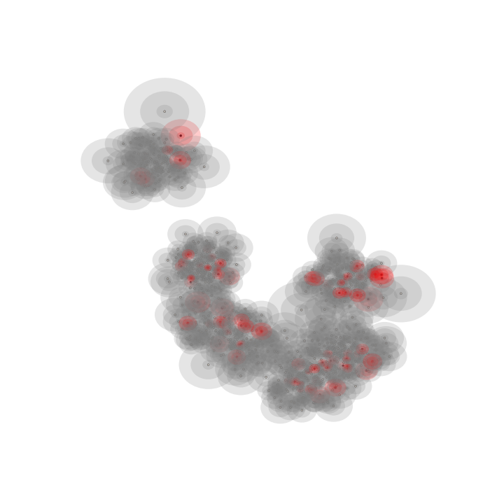

Slide 35
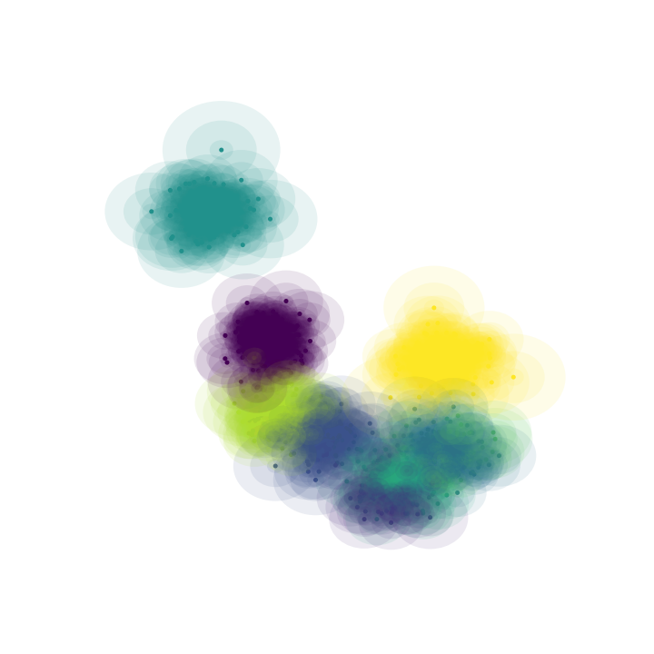

Slide 36


High Abstraction High Granularity
Algorithm
Implementation
Operations
Hardware
Calculate Fuzzy Simplicial Sets:
$∀$ node $n$
$k$-NN in a higher-dimension manifold
Vector unit of CPU
Multi core on a node
$\log{x}$, $e^{x}$
MKL + TBB

Slide 37
High Abstraction High Granularity
Algorithm
Implementation
Operations
Hardware
Vector unit of CPU
Multi core on a node
$\log{x}$, $e^{x}$
MKL + TBB

Slide 38
Steps in our approach
Umap -> graph -> SEIR
Kinds of computations
UMAP Vector, independent possibilities: multithreading, library
SEIR mostly linear algebra, eigen values,
solution of set of differential equations
event driven simulation
multithreading, library
tbb

Slide 40
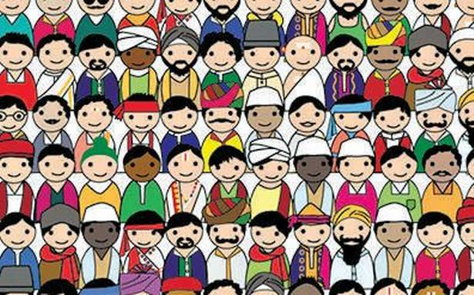
How do we model the spread of an infection?
Starting Population
It just takes one person…
The Susceptible
The Exposed
The Infected

Slide 42




$$\frac{dS}{dt}=Λ−rβS\frac{I}{N}−μS$$
$$\frac{dE}{dt}=rβS\frac{I}{N}−εE$$
$$\frac{dI}{dt}= εE −γI − μI$$
$$\frac{dR}{dt}=γI−μR$$

Slide 44
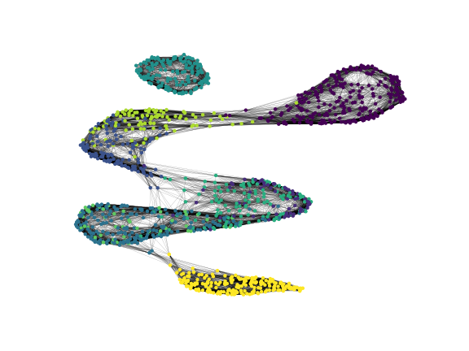
Notes:
Umap is a dimension reduction technique for general non-linear dimension reduction. We assume that the data is uniformly distributed on a Reimannian manifold, the Reimannian metric is locally constant and the manifold is locally connected.
We model the manifold with a fuzzy topological structure

Slide 45
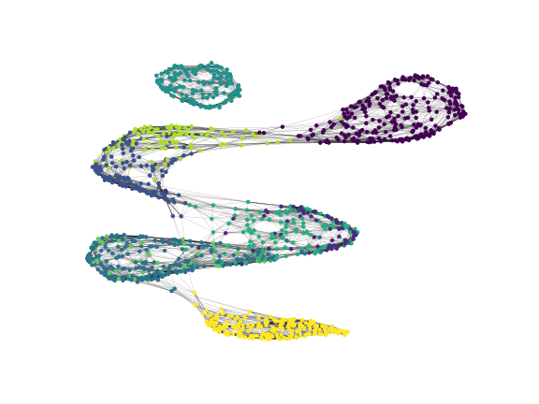

Lockdown effectiveness

Slide 46
Lockdown effectiveness

Slide 47
What’s Missing?
Larger population
Different rates of transmission
Take individual characteristics into account
Location data

Slide 48
What if….?
70K

Slide 49
What if….?
70K
60K
35

Slide 50
What if…. lockdown
70K
20K
150

Slide 51
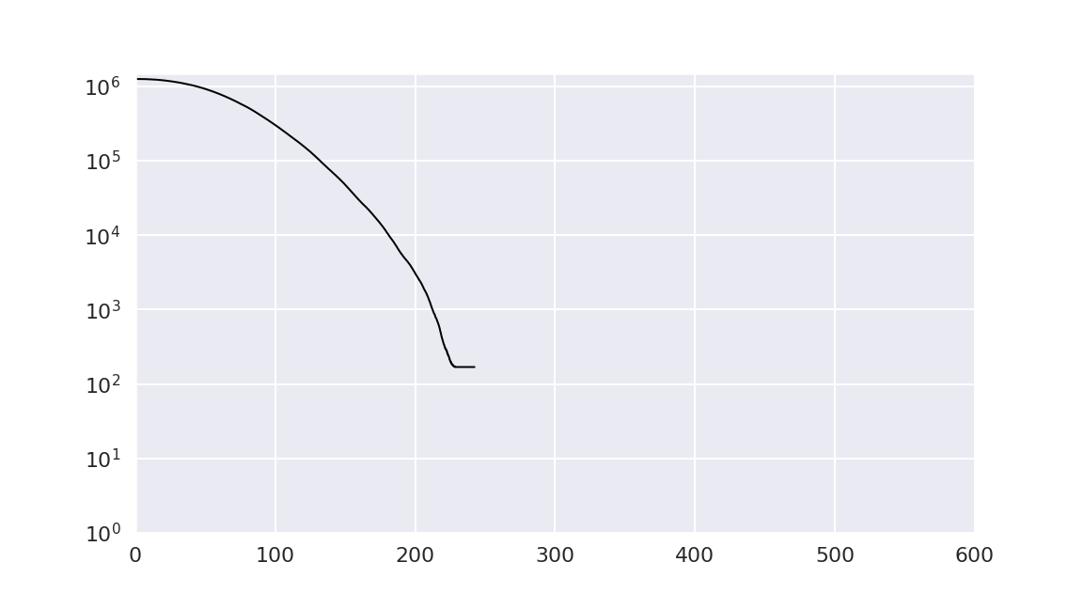

Slide 52
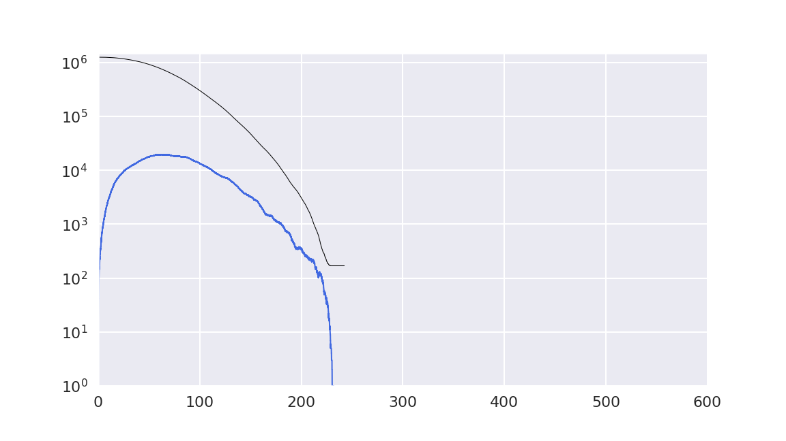

Slide 53
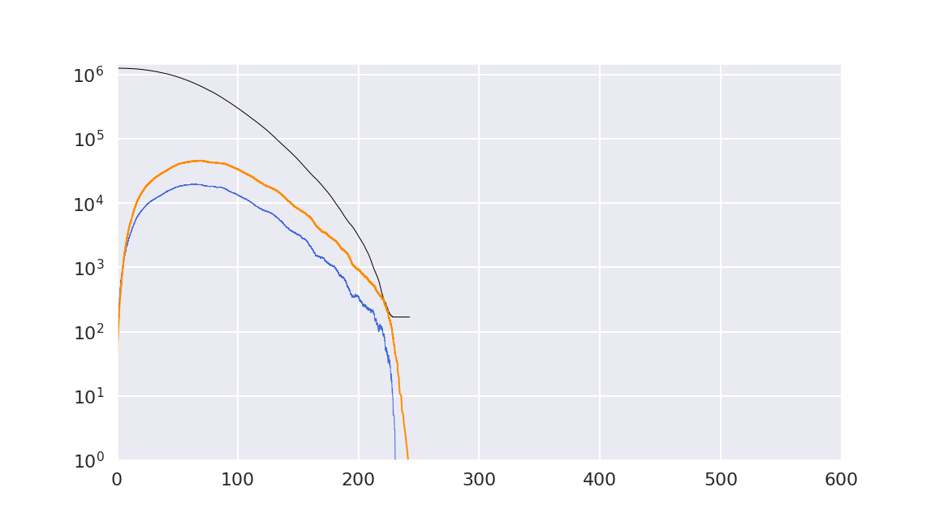

Slide 54
What if…. We Isolated the Super-Spreaders?

Slide 55
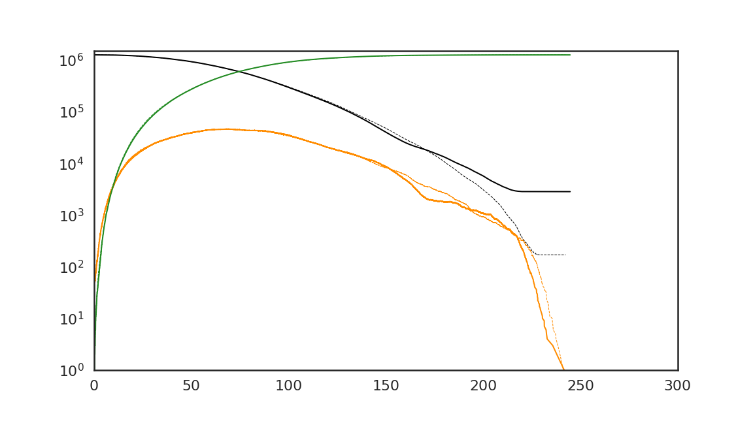
Superspreader 1%

Slide 56
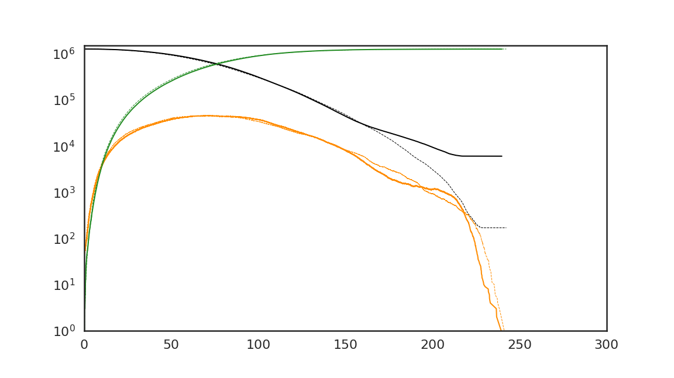
Superspreader 2%

Slide 57
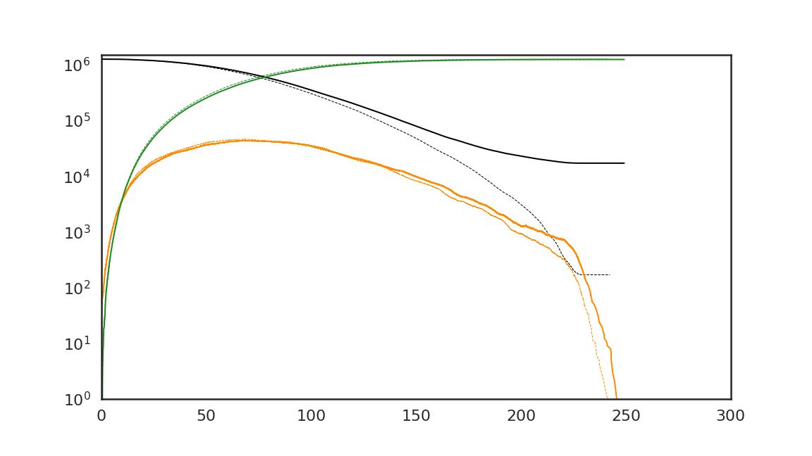
Superspreader 5%

Slide 58
Background Recent reports based on conventional SEIR models suggest that the next wave of the COVID-19 pandemic in the UK could overwhelm health services, with fatalities that far exceed the first wave. These models suggest non-pharmaceutical interventions would have limited impact without intermittent national lockdowns and consequent economic and health impacts.

Slide 59
… We used Bayesian model comparison to revisit these conclusions, when allowing for heterogeneity of exposure, susceptibility, and viral transmission. We used dynamic causal modelling to estimate the parameters of epidemiological models and, crucially, the evidence for alternative models of the same data. We compared SEIR models of immune status that were equipped with latent factors generating data; namely, location, symptom, and testing status. We analysed daily cases and deaths from the US, UK, Brazil, Italy, France, Spain, Mexico, Belgium, Germany, and Canada over the period 25-Jan-20 to 15-Jun-20. These data were used to estimate the composition of each country's population in terms of the proportions of people (i) not exposed to the virus, (ii) not susceptible to infection when exposed, and (iii) not infectious when susceptible to infection.

Slide 60
Bayesian model comparison found overwhelming evidence for heterogeneity of exposure, susceptibility, and transmission. Furthermore, both lockdown and the build-up of population immunity contributed to viral transmission in all but one country. Small variations in heterogeneity were sufficient to explain the large differences in mortality rates across countries. The best model of UK data predicts a second surge of fatalities will be much less than the first peak (31 vs. 998 deaths per day. 95% CI: 24-37)--substantially less than conventional model predictions. The size of the second wave depends sensitively upon the loss of immunity and the efficacy of find-test-trace-isolate-support (FTTIS) programmes. Interpretation A dynamic causal model that incorporates heterogeneity of exposure, susceptibility and transmission suggests that the next wave of the SARS-CoV-2 pandemic will be much smaller than conventional models predict, with less economic and health disruption. This heterogeneity means that seroprevalence underestimates effective herd immunity and, crucially, the potential of public health programmes.

